Slide 1
Sparse Generalized Singular Value Decomposition
Vincent Guillemot, Vincent Le Goff, Ju-Chi Yu, & Hervé Abdi

Slide 2

Some mental images

Slide 3
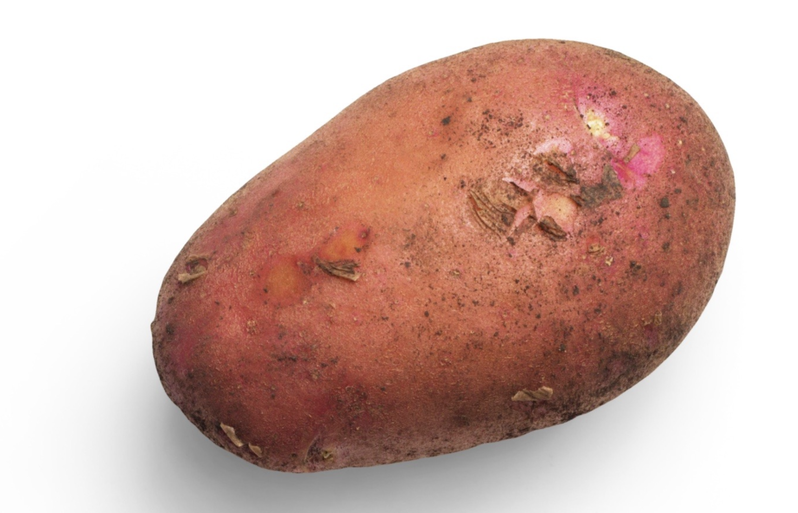
Potato Chips Analysis
Cut the yummiest French fries

Slide 4

Whale versus krill: this is you
Eat the most krill (put on your 3D glasses)
Artwork by @allison_horst https://twitter.com/allison_horst

Slide 5

Whale versus krill: this is your data
Eat the most krill (put on your 3D glasses)
Artwork by @allison_horst https://twitter.com/allison_horst

Slide 6
The tri-force of PCA

Slide 7
The tri-force of PCA
Screeplot
Individual
map
Circle of
correlation

Slide 8
Example data
library(readxl)
xtmp <- read_excel("simul.xlsx")
x <- as.matrix(xtmp[, -1])
rownames(x) <- xtmp$Ind

Slide 9
Example screeplot

Slide 10
Example individual map

Slide 11
Example circle of correlation

Slide 12
Vocabulary

Slide 13
French versus English
English | French
PCA = principal component analysis | ACP = analyse en composantes principales
SVD = singular value decomposition | SVD = décomposition en valeurs singulières
EVD = eigenvalue decomposition | décomposition en éléments propres
ICA = independent component analysis | ICA = analyse en composantes indépendantes
MDS = multidimensional scaling | MDS = multidimensional scaling or analyse du triple
“Aaaaah, mais acépé en fait c’est la pisci-aïe !”
(Anonymous student, after 6 hours of teaching PCA in French)

Slide 14
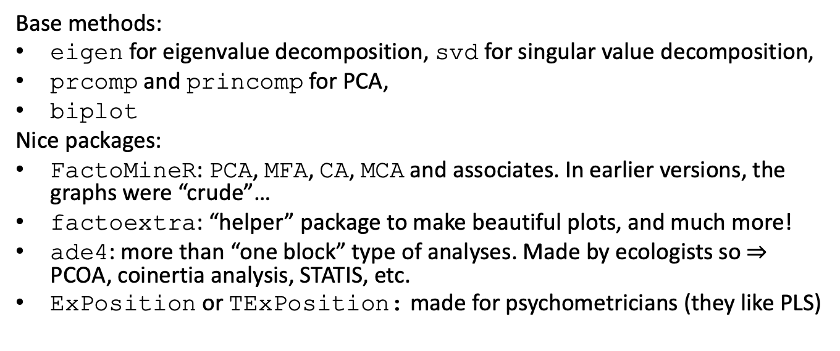
R vocabulary
Base methods:
eigen for eigenvalue decomposition, svd for singular value decomposition,
prcomp and princomp for PCA,
biplot
Nice packages:
FactoMineR: PCA, MFA, CA, MCA and associates. In earlier versions, the graphs were “crude”…
factoextra: “helper” package to make beautiful plots, and much more!
ade4: more than “one block” type of analyses. Made by ecologists so $⇒$ PCOA, coinertia analysis, STATIS, etc.
ExPosition or TExPosition: made for psychometricians (they like PLS)

Slide 15
And a few nice books and papers
MOOC multivariate data analysis by François Husson: https://husson.github.io/MOOC_AnaDo/index.html (FR/EN)
PCA paper(s) by Hervé Abdi: https://personal.utdallas.edu/~herve/abdi-awPCA2010.pdf

Slide 16
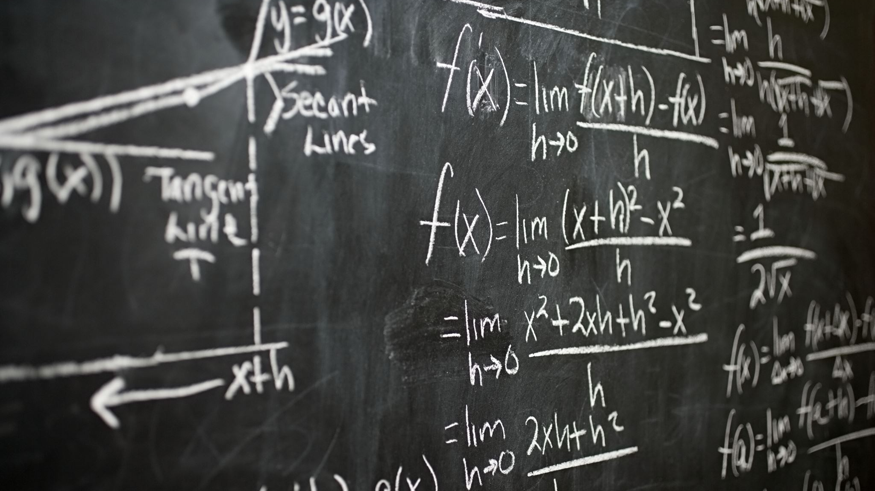
A little bit of Math

Slide 17
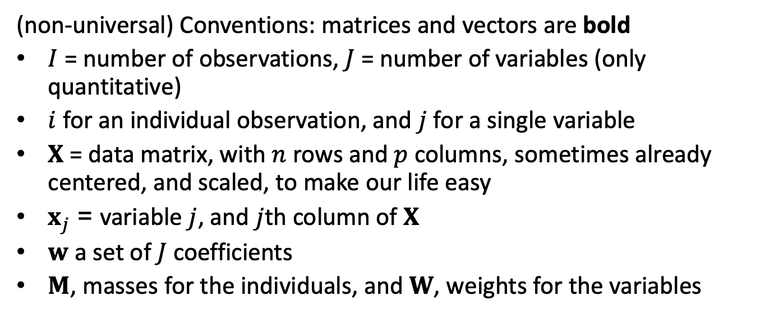
Notations
(non-universal) Conventions: matrices and vectors are bold
$I$ = number of observations, $J$ = number of variables (only quantitative)
$i$ for an individual observation, and $j$ for a single variable
$X$ = data matrix, with $n$ rows and $p$ columns, sometimes already centered, and scaled, to make our life easy
$x_{j}$ = variable $j$, and $j$th column of $X$
$w$ a set of $J$coefficients
$M$, masses for the individuals, and $W$, weights for the variables

Slide 18
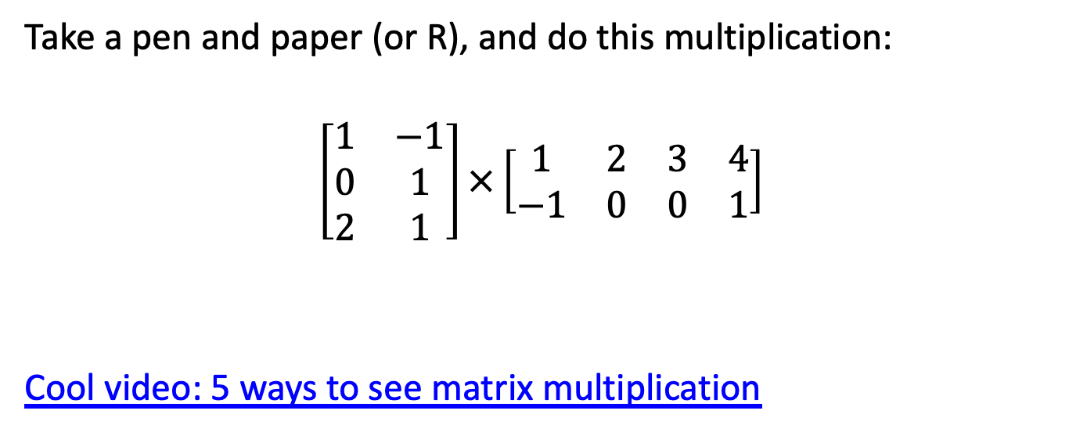
A little detour: matrix multiplication
Take a pen and paper (or R), and do this multiplication:
$$\left[\begin{matrix}1 & −1 \\ 0 & 1 \\ 2 & 1\end{matrix}\right]×\left[\begin{matrix}1 & 2 & 3 & 4 \\ −1 & 0 & 0 & 1\end{matrix}\right]$$
Cool video: 5 ways to see matrix multiplication

Slide 19
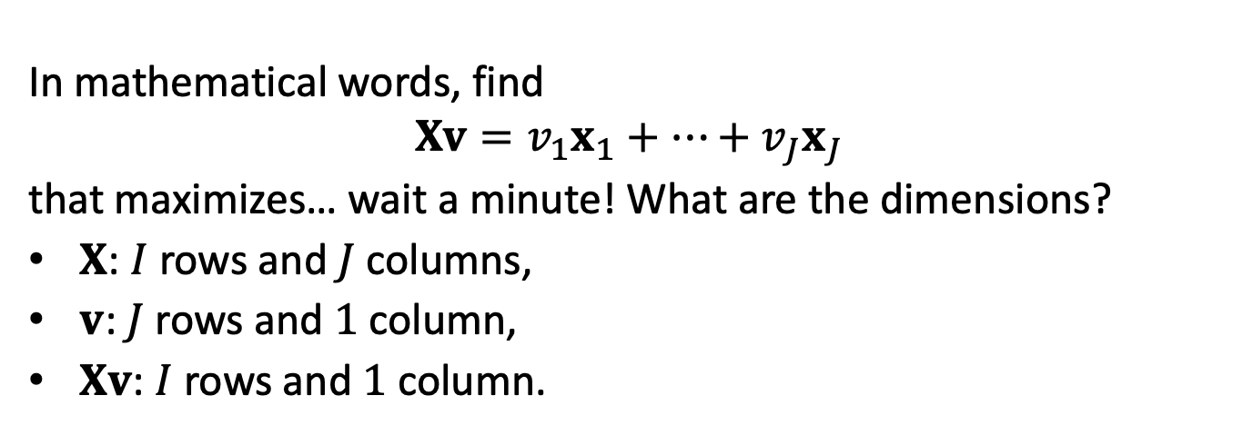
PCA
“Find a linear combination of the columns of the data that would capture the most information.”
In mathematical words, find
$$Xv=v_{1}x_{1}+⋯+v_{J}x_{J}$$
that maximizes… wait a minute! What are the dimensions?
$X$: $I$ rows and $J$ columns,
$v$: $J$ rows and $1$ column,
$Xv$: $I$ rows and $1$ column.

Slide 20

The mathematical translation of the intuitions behind PCA

Slide 21
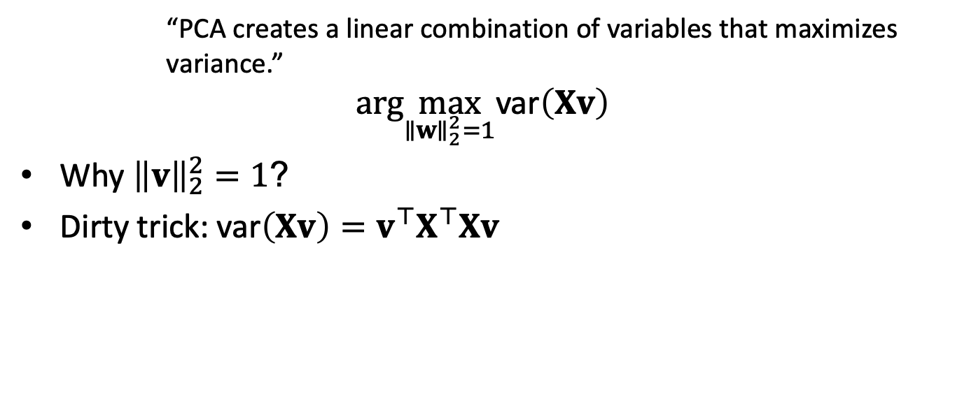
Most popular intuition of PCA: how does it translate?
“PCA creates a linear combination of variables that maximizes variance.”
$$arg\max_{∥w∥_{2}^{2}=1}\text{var}\left(Xv\right)$$
Why ${\left\|v\right\|}_{2}^{2}=1$?
Dirty trick: $\text{var}\left(Xv\right)=v^{⊤}X^{⊤}Xv$

Slide 22
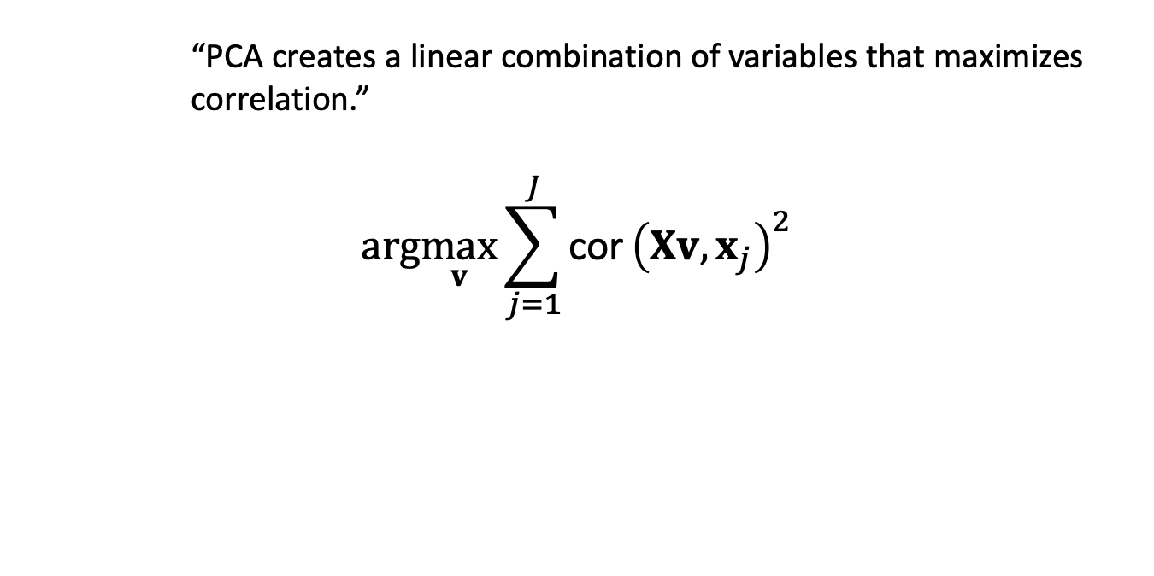
Least “well-known” intuition of PCA: how does it translate?
“PCA creates a linear combination of variables that maximizes correlation.”
$$arg\max_{v}\sum_{j=1}^{J}{\text{cor}}{\left(Xv,x_{j}\right)}^{2}$$

Slide 23
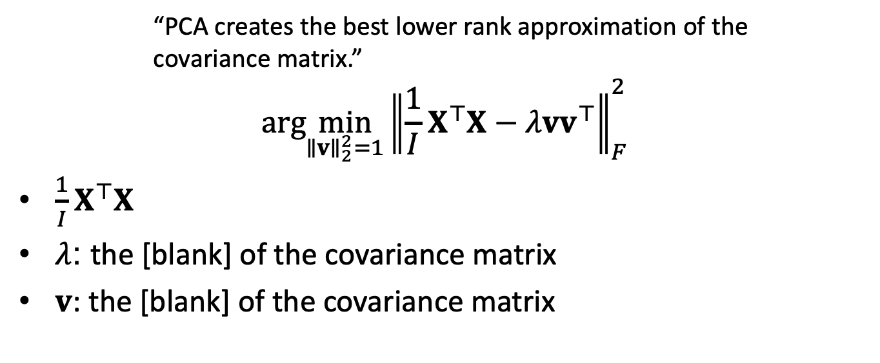
Second least “well-known” intuition of PCA: how does it translate?
“PCA creates the best lower rank approximation of the covariance matrix.”
$$arg\min_{∥v∥_{2}^{2}=1}{∥\frac{1}{I}X^{⊤}X−λvv^{⊤}∥}_{F}^{2}$$
$\frac{1}{I}X^{⊤}X$
$λ$: the [blank] of the covariance matrix
$v$: the [blank] of the covariance matrix

Slide 24
A little image

Slide 25
Rank-1 approximations

Slide 26
Increasing rank approximations

Slide 27
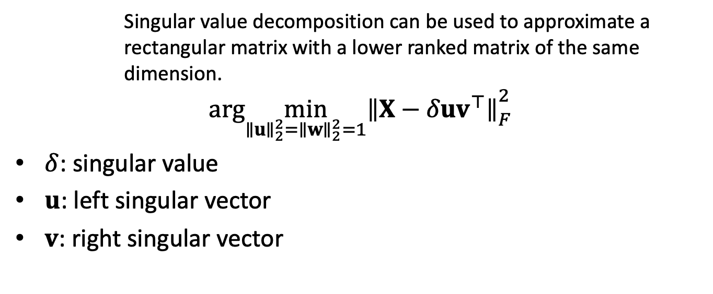
We can do the same kind of magic with the data itself
Singular value decomposition can be used to approximate a rectangular matrix with a lower ranked matrix of the same dimension.
$$arg\min_{∥u∥_{2}^{2}=∥w∥_{2}^{2}=1}{∥X−δuv^{⊤}∥}_{F}^{2}$$
$δ$: singular value
$u$: left singular vector
$v$: right singular vector

Slide 28
Rank 1 approximation

Slide 29
Rank-1 approximations

Slide 30
Increasing rank approximations

Slide 31
Constraining the (Generalized) SVD

Slide 32
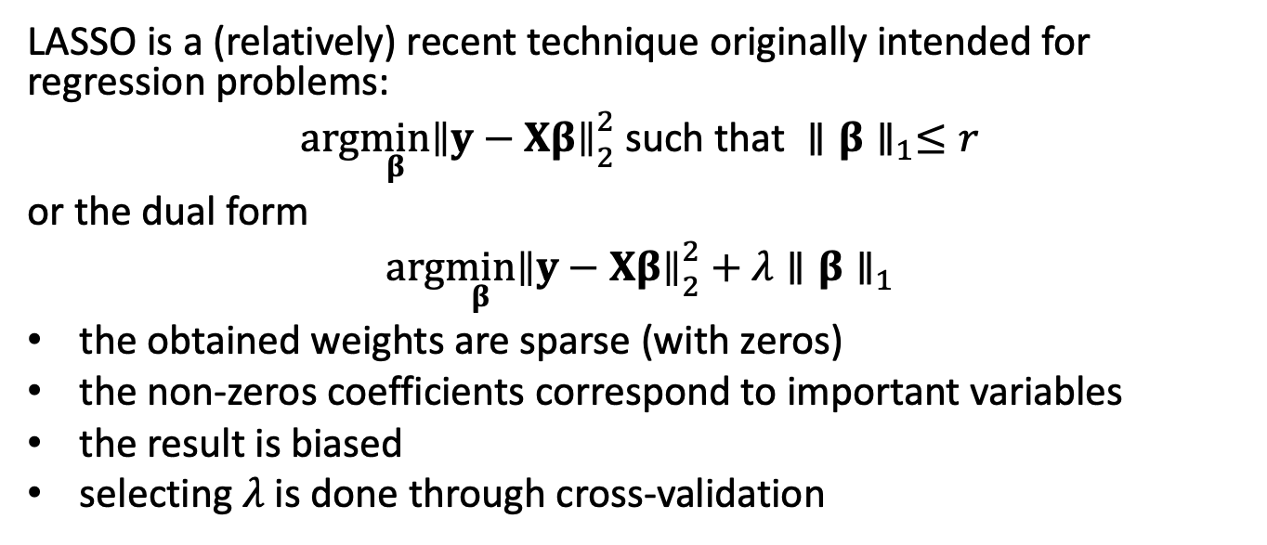
LASSO
LASSO is a (relatively) recent technique originally intended for regression problems:
$$arg\min_{β}{∥y−Xβ∥}_{2}^{2} \text{such} \text{that} ∥β∥_{1}≤r$$
or the dual form
$$arg\min_{β}{∥y−Xβ∥}_{2}^{2}+λ∥β∥_{1}$$
the obtained weights are sparse (with zeros)
the non-zeros coefficients correspond to important variables
the result is biased
selecting $λ$ is done through cross-validation

Slide 33
Optimization problem
$$\begin{matrix}\left(δ_{ℓ},p_{ℓ},q_{ℓ}\right)=arg\min_{β}{∥X−δp^{⊤}q∥}_{2}^{2} \\ \text{such} \text{that} \left\{\begin{matrix}p^{⊤}Mp=q^{⊤}Wq=1 \\ p^{⊤}Mp_{ℓ^{′}}=q^{⊤}Wq_{ℓ^{′}}=0,∀ℓ^{′}<ℓ \\ ∥p∥_{1}≤s_{p,ℓ} \text{and} ∥q∥_{1}≤s_{q,ℓ}\end{matrix}\right.\end{matrix}$$

Slide 34
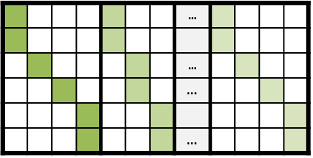

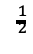
Sparse GSVD (sGSVD) and sparse MCA (sMCA)
Sparsify the GSVD: the sparse GSVD (sGSVD)
Intersection of 3 spaces
L₁-ball
L₂-ball
Orthogonal space:
Sparse MCA (sMCA)
Generalize L₁-constraint
Group constraint:
L_{(1,2)}-norm: sum of L₂-norms
L₂-norms: [(Level 1 loading)² + (Level 2 loading)² + $⋯$]
with weights P^{T}W_{X}P = I
P⊥
W_{X}P⊥
$$^{\frac{1}{2}}$$
P
one loading
W_{X}P
Notes:
Generalized the L1 constraint by including the L2 norms of the variables and imposing constraints on the L12 norm.
Set a limit for the norm which becomes the L1 norm of these L2 norms.
The L2 norms here are the sq of SS of all loadings that belong to the same variable.
With this new constraints, we sparsify a group of loadings at the same time.

Slide 35
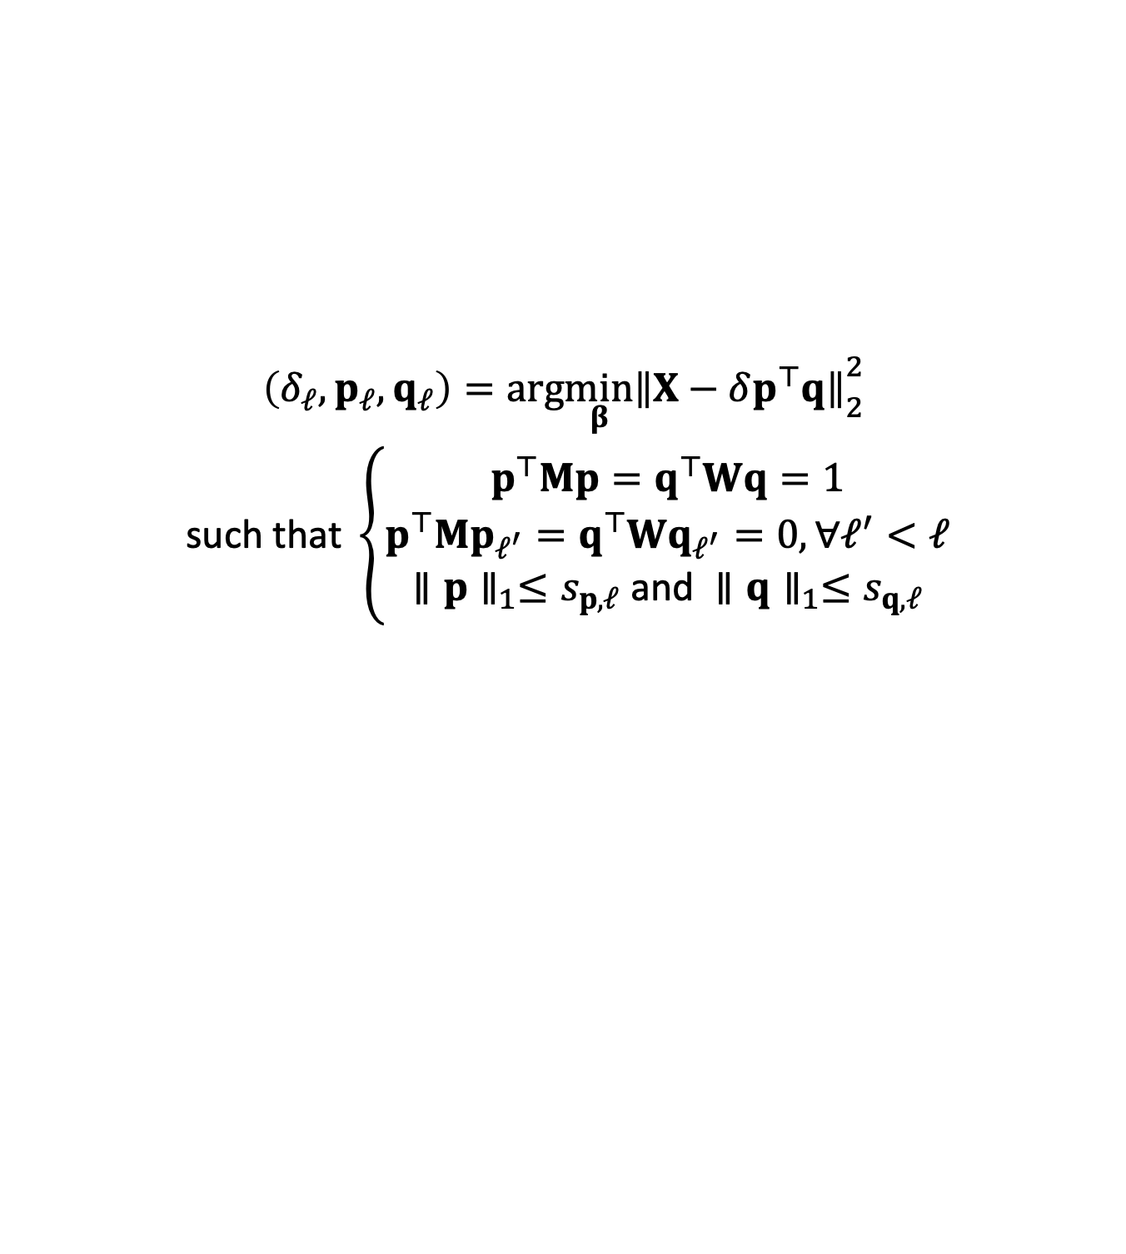
Optimization problem
$$\begin{matrix}\left(δ_{ℓ},p_{ℓ},q_{ℓ}\right)=arg\min_{β}{∥X−δp^{⊤}q∥}_{2}^{2} \\ \text{such} \text{that} \left\{\begin{matrix}p^{⊤}Mp=q^{⊤}Wq=1 \\ p^{⊤}Mp_{ℓ^{′}}=q^{⊤}Wq_{ℓ^{′}}=0,∀ℓ^{′}<ℓ \\ ∥p∥_{1}≤s_{p,ℓ} \text{and} ∥q∥_{1}≤s_{q,ℓ}\end{matrix}\right.\end{matrix}$$

Slide 36
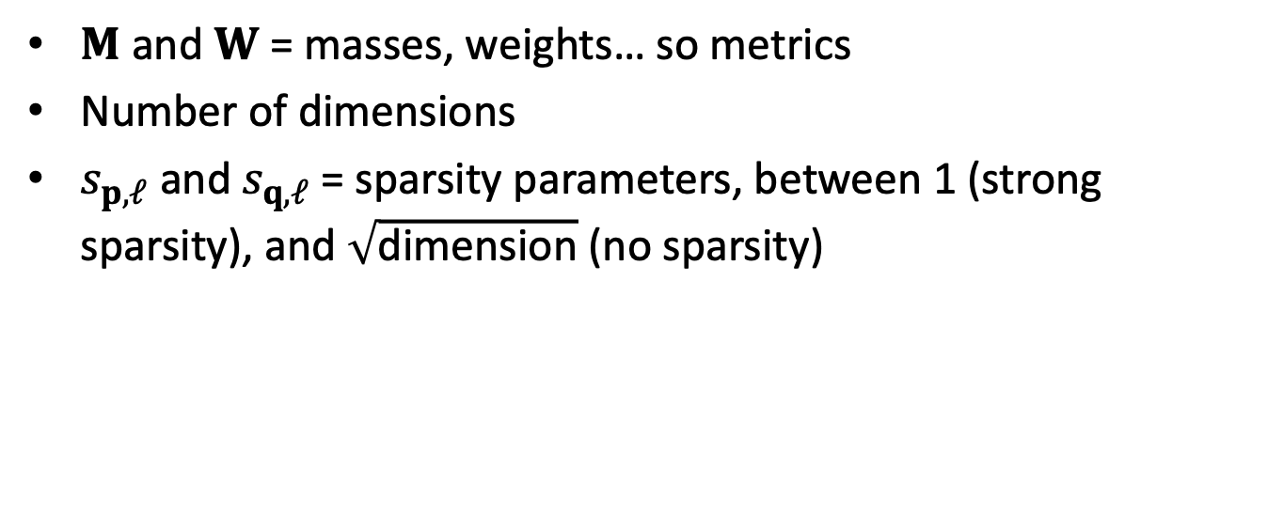
What are the parameters?
$M$ and $W$ = masses, weights… so metrics
Number of dimensions
$s_{p,ℓ}$ and $s_{q,ℓ}$ = sparsity parameters, between 1 (strong sparsity), and $\sqrt{\text{dimension}}$ (no sparsity)

Slide 37
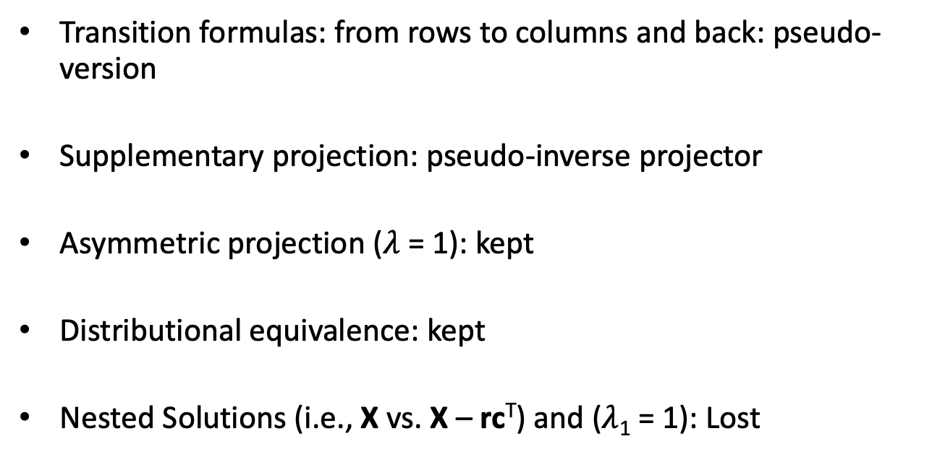
Lost & Found
Transition formulas: from rows to columns and back: pseudo-version
Supplementary projection: pseudo-inverse projector
Asymmetric projection ($λ$ = 1): kept
Distributional equivalence: kept
Nested Solutions (i.e., X vs. X – rc^{T}) and ($λ$₁ = 1): Lost

Slide 38
A few fun papers
We belong to the fan club of: (Witten, Tibshirani, and Hastie 2009; Trendafilov 2014, Journee2010).
Our work on:
Constrained Singular Value Decomposition (Guillemot et al. 2019)
Sparse Correspondence Analysis (Abdi et al. 2024)
Sparse Multiple Correspondence Analysis (Guillemot et al. 2020; Yu et al. 2024)

Slide 39
References
Abdi, Hervé, Vincent Guillemot, Ruiping Liu, Ndèye Niang, Gilbert Saporta, and Ju-chi Yu. 2024. “From Plain to Sparse Correspondence Analysis: a Generalized SVD Approach.” Statistica Applicata - Italian Journal of Applied Statistics 35 (3): 1–39. https://doi.org/10.26398/IJAS.0035-014.
Guillemot, Vincent, Derek Beaton, Arnaud Gloaguen, Tommy Löfstedt, Brian Levine, Nicolas Raymond, Arthur Tenenhaus, and Hervé Abdi. 2019. “A constrained singular value decomposition method that integrates sparsity and orthogonality.” Edited by Shyamal D Peddada. PLOS ONE 14 (3): e0211463. https://doi.org/10.1371/journal.pone.0211463.
Guillemot, Vincent, Julie Le Borgne, Arnaud Gloaguen, Arthur Tenenhaus, Gilbert Saporta, Sylvie Chollet, Derek Beaton, and Hervé Abdi. 2020. “Sparse Multiple Correspondence Analysis.” In 52èmes Journées de Statistique, 830–35. 52èmes Journées de Statistiques de La Société Française de Statistique (SFdS). Nice, France: Société Française de Statistique (SFdS). https://pasteur.hal.science/pasteur-03037346.
Trendafilov, Nickolay T. 2014. “From Simple Structure to Sparse Components: A Review.” Computational Statistics 29 (3-4): 431–54.
Witten, Daniela M, Robert Tibshirani, and Trevor Hastie. 2009. “A Penalized Matrix Decomposition, with Applications to Sparse Principal Components and Canonical Correlation Analysis.” Biostatistics 10 (3): 515–34.
Yu, Ju-Chi, Julie Le Borgne, Anjali Krishnan, Arnaud Gloaguen, Cheng-Ta Yang, Laura A. Rabin, Hervé Abdi, and Vincent Guillemot. 2024. “Sparse Factor Analysis for Categorical Data with the Group-Sparse Generalized Singular Value Decomposition.” Computational Statistics and Data Analysis.

